Slide 1
Business solution plan on Bluemix
- China market
Hai Feng Liu
Oct 2015

Slide 2
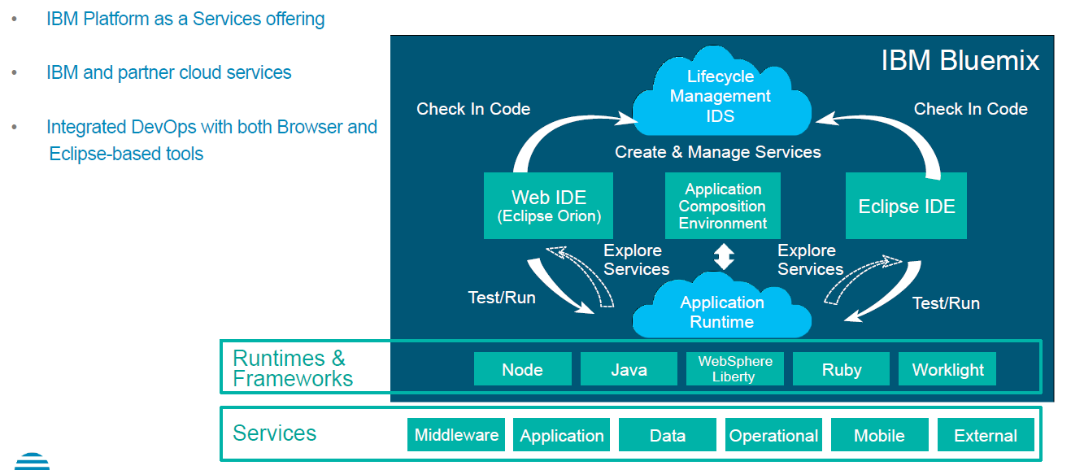
Background and Approach
Bluemix Offering includes:
  IBM, Open source & 3rd party services in the catalog
  Rational requirements management, defect tracking, build and deploy
  Git compatible source control
  Runtimes and buildpacks (node, java, WebSphere Liberty, ruby, php)
  Starter kits for Mobile, Internet of Things, Web, and other types of apps
According to our understanding China market is a dynamic market there are different requirements We recommend to differentiate China Bluemix offering by strengthening Catalog service. By assembling a virtual team to develop business system prototypes for China market. The business system select criteria are list as below:
  Analytics, Mobile, Social
  System is not very complex system
  Requirement is dynamic and request fast iterative implement

Slide 3
1. Customer Information and Billing System
Opportunity:
Currently there are only 2 electric power retailer in China(State Grid, China Southern Power Grid). In the near future per the de-regulation of retail business of electric power in China, there will be new retailers entering into the market.
Solution:
IBM build Customer Information and Billing System on IBM Bluemix platform. The system will enable retailer to run power retail business through customer management to billing and settlement business.

Slide 4
Solution System Context
CRM System
Call Center System
JEPX
Customer Information
Contact Information
Power Price
Customer
Power Trade Info
RTO and EPC System
Customer Information and Billing System
Consignment Switching
Agent
Meter Data Information
Payment Information
Bank
Staff
Weather Info
Report
Manager
Local Government
Weather Forecast Org
Client Internal system
3rd Party system
IBM Confidential
Notes:
SLIDE GUIDANCE / INSTRUCTIONS: Recommended slide for CS deals. Optional slide for AMS deals.
The proposed system context diagram shows the entire system represented as a single object or process, and identifies its interfaces with external entities of the system. Include any existing context diagrams shared by the client in Section 3.1.
The level of the details will depend on the service lines and the types of deals.

Slide 5
1. Customer Information and Billing System
No | Module | Requirements | Description
1 | Customer Portal | Introduction and Notification
 |  | Fee simulation | This can be exposed as API service in Bluemix
 |  | New Contract request
 |  | Contract Modification request
 |  | Question and Answer
 |  | Electric Power Consumption View
 |  | Monthly billing information
 |  | Account information Modification
2 | Agent Portal | Customer Information
 |  | Contract Management
 |  | New Contract request
 |  | Customer contact list view
 |  | Notification list view
 |  | Customer engagement status
 |  | New Contract, Contract Cancellation report
 |  | Question and Answer
3 | Customer and Agent Management | Customer Request Validation
 |  | Bank Card With holding confirmation
 |  | Customer Management
 |  | Customer Contact List View
 |  | Customer Payment history view
 |  | Collection Agent’s Account confirmation

Slide 6
1. Customer Information and Billing System
No | Module | Requirements | Description
4 | Contract Management | Contract Termination Notification
 |  | Contract Status View
5 | Billing and Fee | Bill Amount Calculation
 |  | Bill Amount Report
 |  | Agent fee calculation
6 | Collection Management | Bill Distribution
 |  | Payment Information
 |  | Bill and Collection Process
7 | Bill Information Revise | Bill Amount Re-Calculation
 |  | Bill Amount Re-Calculation Report
8 | Agent Collection Management | Collection Data Export to Agent
 |  | Collection Data Import from Agent
9 | Unpaid Bill Management | Payment Confirmation
 |  | Unpaid bill report
 |  | Dunning Management
6 | Demand and Supply Management | Demand and Supply Forecast
 |  | Imbalance monitoring
 |  | Demand and Supply Adjustment
 |  | Electric Power procurement
 |  | Supply plan
 |  | Report and Dashboard

Slide 7
2. Internet Marketplace Commerce Platform
Opportunity:
Currently there are digital commerce requirements in China markets especially marketplace commerce opportunities. IBM WebSphere Commerce system does not fit well for these requirements.
Solution:
IBM build internet marketplace commerce system on IBM Bluemix platform. The system will enable marketplace owner to rent store for seller/supplier to run retail business online and customer can shopping at the marketplace stores.
Module and Features:
Marketplace
  Seller/supplier onboarding
  Product Information Management
  Seller/supplier management : ratings, billing, shops
  Marketplace inventory management
  Marketplace orders management
  Trust and safety management
  Performance management
Shopping and Order
  Registration
  My Account
  Catalog Browsing
  Marketing and Promotions
  Catalog Search
  Configurator
  Wish List
  Shopping Cart/Current Order
  Place Order
  Store Locator

Slide 8
3. Internet Banking System
Opportunity:
Although many of the large and middle banks in China have Internet banking now, but there still are lots Internet banking opportunities from small banks. As Internet banking is another effective delivery channel made the banks to attract more customers and improve its customer service.
Solution:
IBM build digital Internet banking system on IBM Bluemix platform. The system will enable customer of bankers to manage personal account and perform self service online. It makes the banking operations simple and cost effective thus banks can utilise the man power in an efficient way. All banking transactions are done through this channel like funds transfer, utility payment, balance query, statements, etc. No restriction for customers about the banking hours and the transactions are done at any time at the convenience of the customers. Also customers can monitor their account regularly to avoid any fraudulent transactions.

Slide 9
Main Features in a Typical IB System
  Account information
    Statements and checking of account history
    Alerts on account activity or passing of set thresholds
    Monitoring of term deposits
    Access to loan statements
    Access to card statements
    Mutual funds / equity statements
    Insurance policy management
  Transaction
    Funds transfers between the customer's linked accounts
    Paying third parties, including bill payments and third party fund transfers(see, e.g., FAST)
    Check Remote Deposit
  Investments
    Portfolio management services
    Real-time stock quotes
    Personalized alerts and notifications on security prices
  Support
    Status of requests for credit, including mortgage approval, and insurance coverage
    Check (cheque) book and card requests
    Exchange of data messages and email, including complaint submission and tracking
    Branch/ATM Location
  Content services
    General information such as weather updates, news
    Loyalty-related offers
    Location-based services
IBM Confidential

Slide 10
High Level Solution Architecture for a Typical IB
Internet Banking
Mobile Banking
Other Supporting Applications:
Marketing and Advertisement(Unica etc)
Social Integration (Wechat, Weibo etc)
Traditional Payment (VISA/Master/Unipay etc)
Third-party Payment Integration (Tenpay, Alipay, Apple Pay, Paypal etc)
Credit Reference (PBC, 3rd part credit reference like Tecent Credit/Alipay Credit etc)
Communication
Infrastructure
-PBX
-CTI Soft Phone
Telephone Banking
（IVR Application）
Integrated DB
-Application DB
Core Banking Gateway
IVR N/W
WEB Portal
-CMS (Staging)
-Home Page
Business
Batch Application
WEB Admin/Mail Publisher
Intranet Application Management
Data Migration Tool
System Operation
Application
Distributed Infrastructure
-AIX Infra. –Linux Infra.（Mail System)
Infrastructure
IBM Confidential

Slide 11
Technical Solution and Programming Language
Internet Banking
Mobile Banking
Telephone Banking
（IVR Application）
Business Batch Application
WEB Portal(Customer Portal)
–CMS(Staging)
Java
JDBC
WEB Admin/Mail
Intranet Application Management
WACs
Common
Shell Script
JOB Net/
Job
Spring FW
JDBC
Java SE
AIX Ksh
MQ
JavaScript/CSS
JSP
HTML
Java
MQ
JP1
Web Services
Consumer
Stored Procedure
WACs Web/Common Feature
SAML SP
Spring FW
Oracle DB Sever
Java EE/SE
SVF
VASCO
*Encryption
WEB Portal (Customer Portal)
-Home Page
Core Banking Gateway
Integrated DB
-Application DB
Oracle
JavaScript/CSS
Static
HTML
C Language
MQ
Socket
HTTP Server
-Data Migration Tool
Core Banking Server Asset/Framework
Java or Shell Script
Product, Asset
Applicaton
Program
1.Scope and Solution architecture
IBM Confidential

